Slide 1





SPECS & FEATURES
SOLUTION
TEAM OF JOHN
PROBLEM
SPECIALS 4 U
IMPLEMENTATION

Slide 2
GROUP MEMBERS
NOKUHLE NGUBANE
THOKOZANI MTSHALI
ADRIAN BELO
BRIAN MABUKWA
KGATLHISO MOKGATLE
JOHN OLU-DANIELS JR

Slide 3

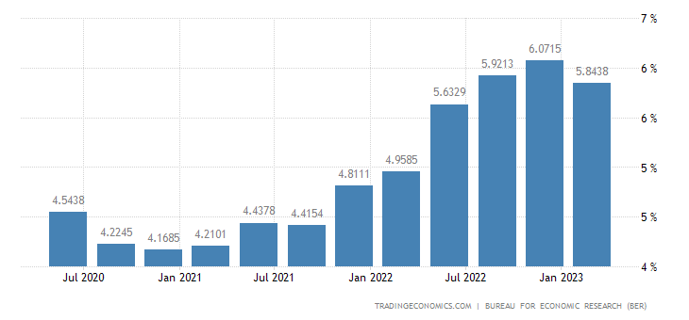
PROBLEM
South Africa’s inflation rate has consistently been increasing over the years and the cost of living increased, decreased livelihoods
Affecting the livelihoods of lower income families and students.
Budgeting for grocery shopping has become difficult due to frequent price increases.

Slide 4

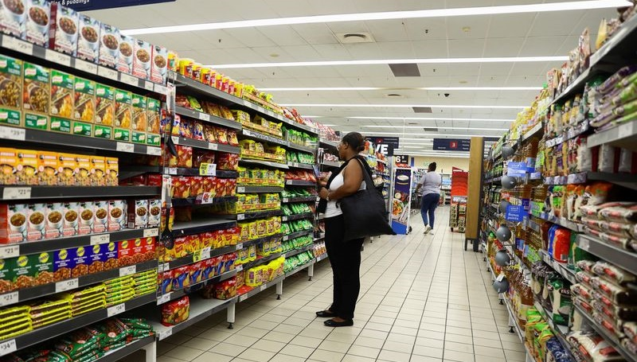
SOLUTION
A website that is used make grocery shopping easier and more affordable.
Enables users to spend less on monthly grocery shopping and find value for money to survive the plummeting economy.
SOLUTION
A lot of text gos here but nothing has been allocated to use aas a ttoll to us the lorem fagwv bbbbbbbbbbbbbbbbb
bbbbbbbbbbbbbbbbbgrsrrr2333ool

Slide 5

SPECS & FEATURES
Website:
Grocery store specials!
Finds the grocery store branches close to user.
Compiles grocery list with estimated total cost.
User can:
Create account & have a profile
Write a shopping list for every shopping trip.
A “Favourites” products list
Report ‘out of stock’ products

Slide 6
CRUED
C
REATE: user can create a profile.
R
EAD/RETRIEVE: website reads data from the database
PDATE: website updates specials daily.
U
E
DIT: user can edit their profile’s details.
D
ELETE: user can delete their profile.

Slide 7

IMPLEMENTATION
HTML, CSS & JavaScript:
Using them to design the webpages and add functionality to them to a fully functional
website
MySQL:
To create the database & store user information.
PHP:
To link the website and database
Python:
Use it for web scraping & GPS.

Slide 8

PROFIT
The retail franchises will be using or website to advertise their sales.
We will offer advertising for the retail franchises’ delivery apps (Checkers Sixty60, PicknPay asap!, Woolies Dash etc.)
Selling information to insurance companies & banks.

Slide 9
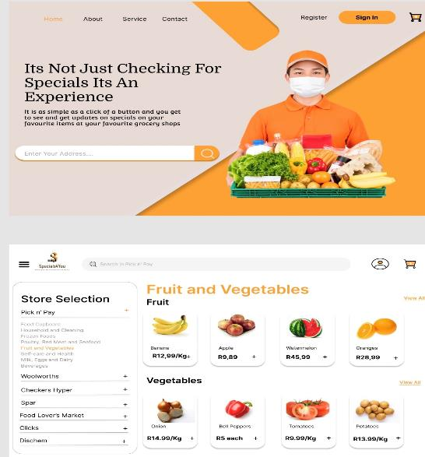
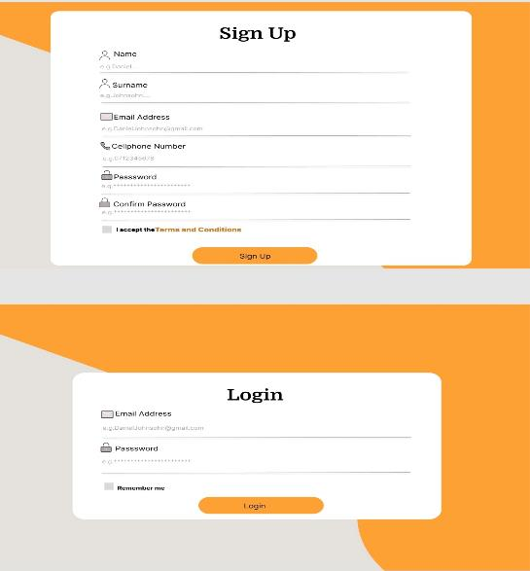
PROTOTYPE

Slide 10
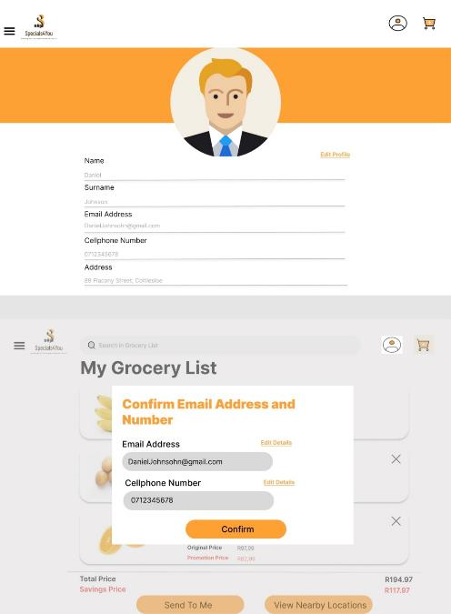
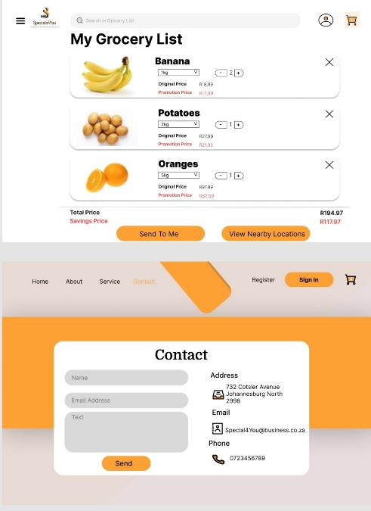
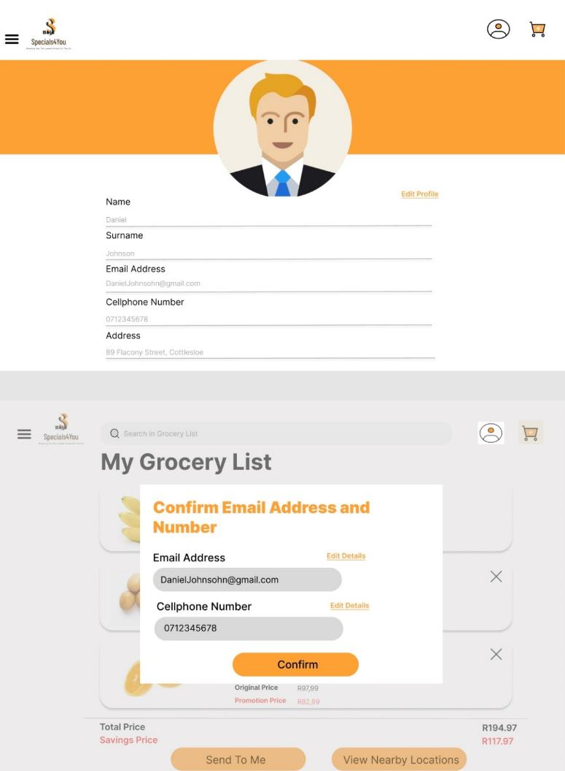

Slide 11
